Slide 1

[Pizza Heist Code
Walkthrough]
More details included in the code comments…
Notes:
asdasdsa

Slide 2
[Text Writer Files]

Slide 3
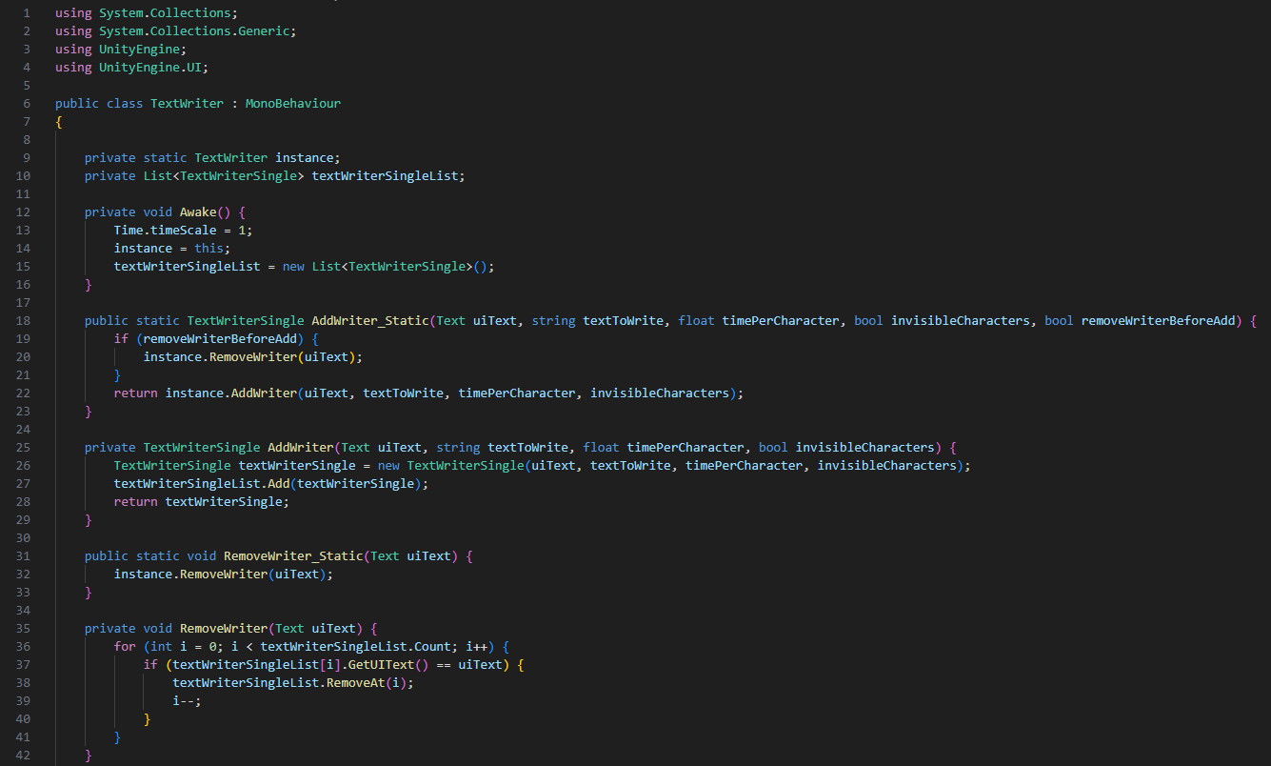
TextWriter.cs
Displays a string of text onto a UI text element, one character at a time, similar to a typewriter.
Used for all text elements throughout the game.

Slide 4
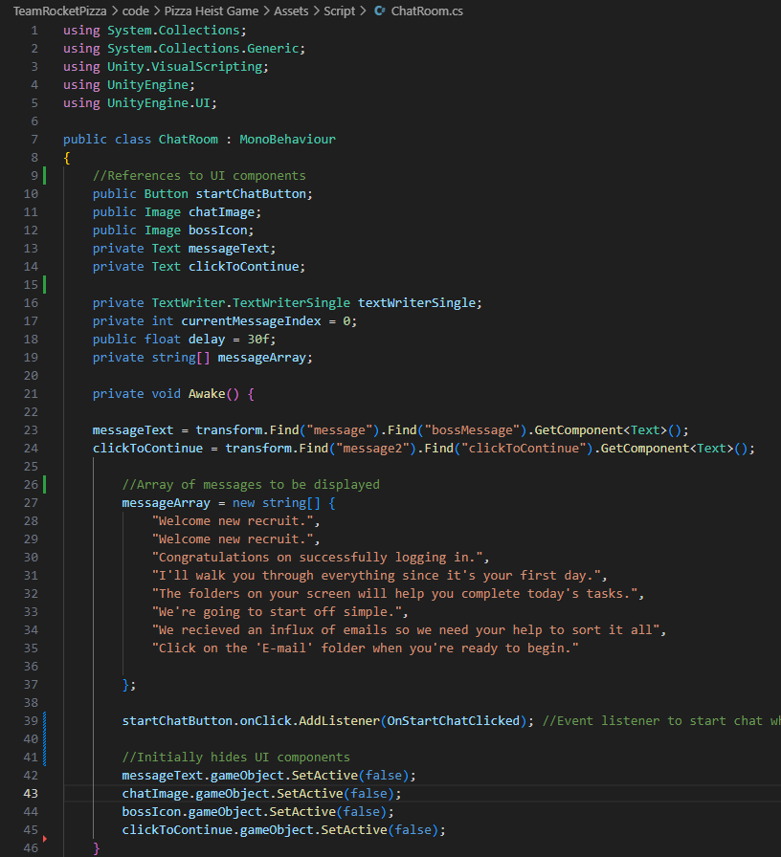
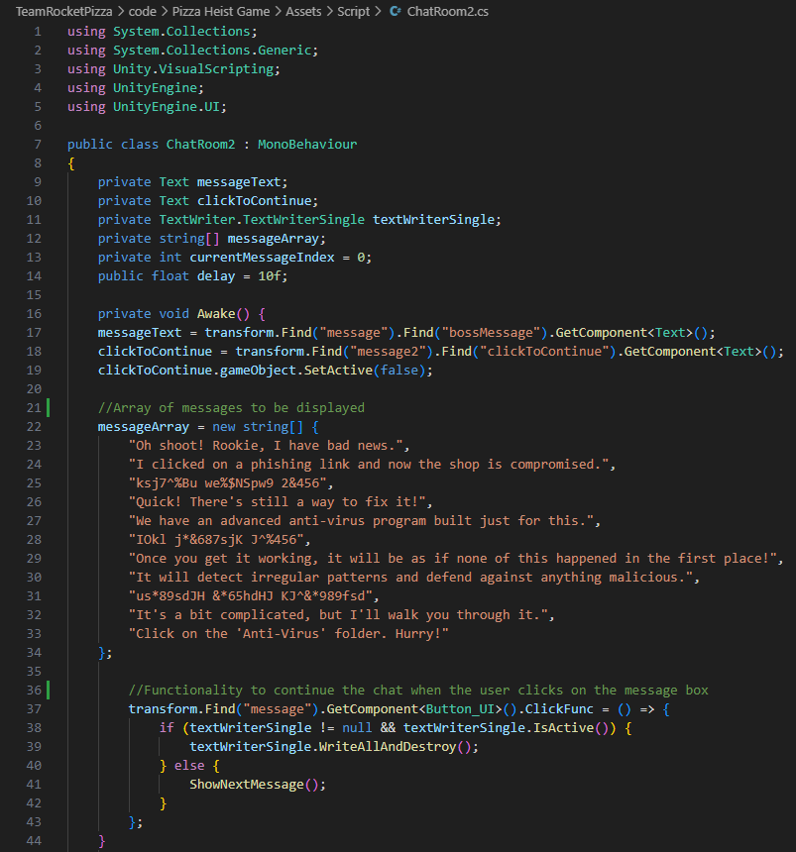
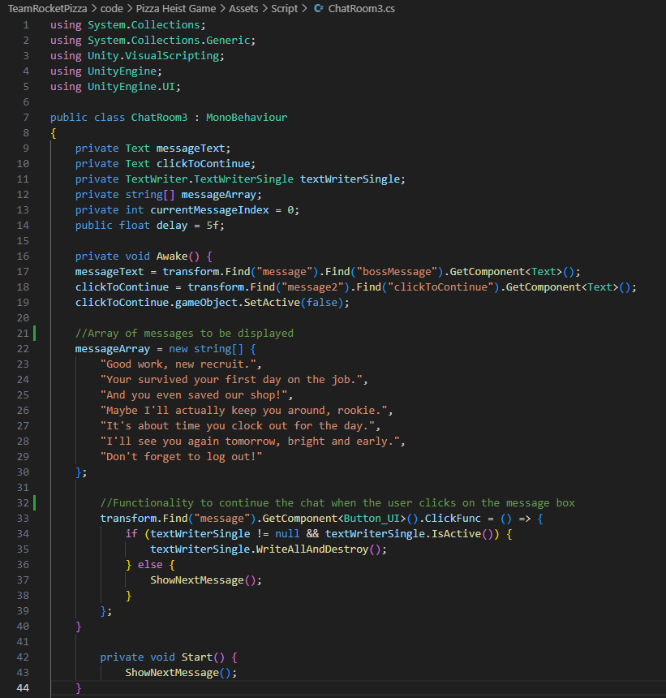
ChatRoom Files
Left to Right: ChatRoom.cs, ChatRoom2.cs, ChatRoom3.cs
Calls the TextWriter function to print an array of text to print the messages as seen on the different Desktop scenes

Slide 5
[Tower Defense Files]

Slide 6
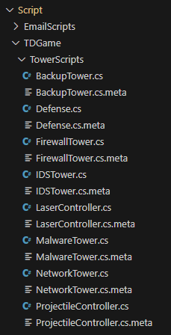
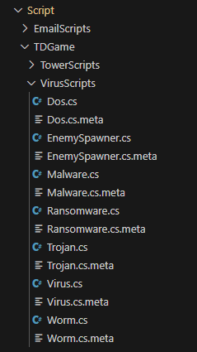
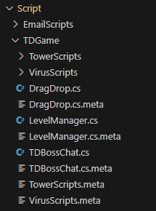
Folders
All of the Tower Defense files are located in the “TDGame” folder. Tower and Virus files are in their respective folders.

Slide 7
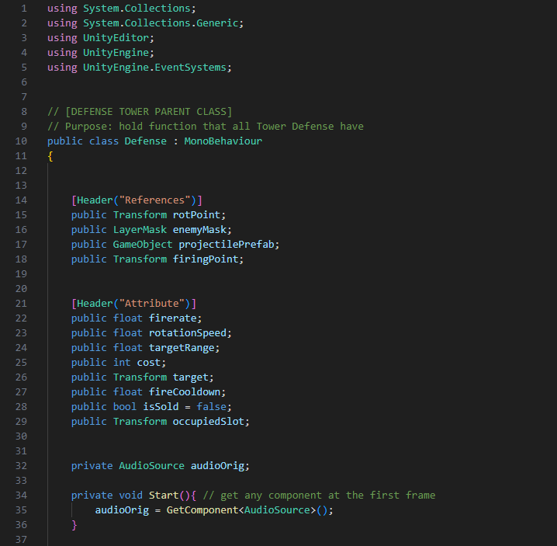
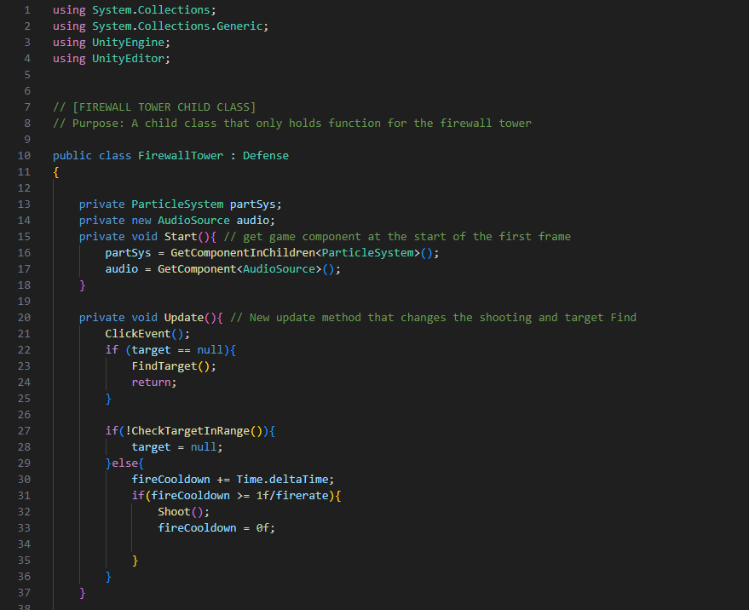
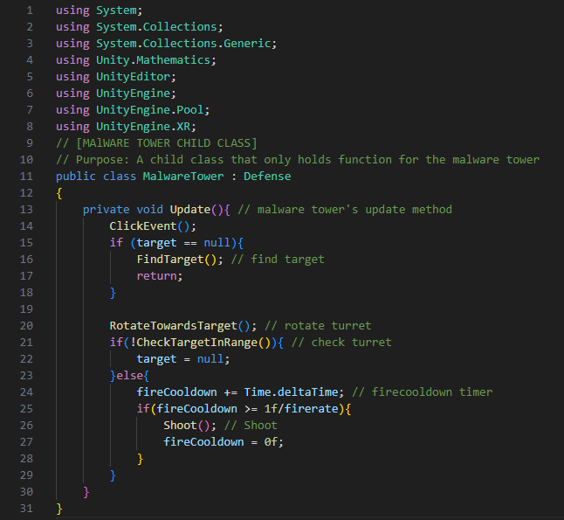
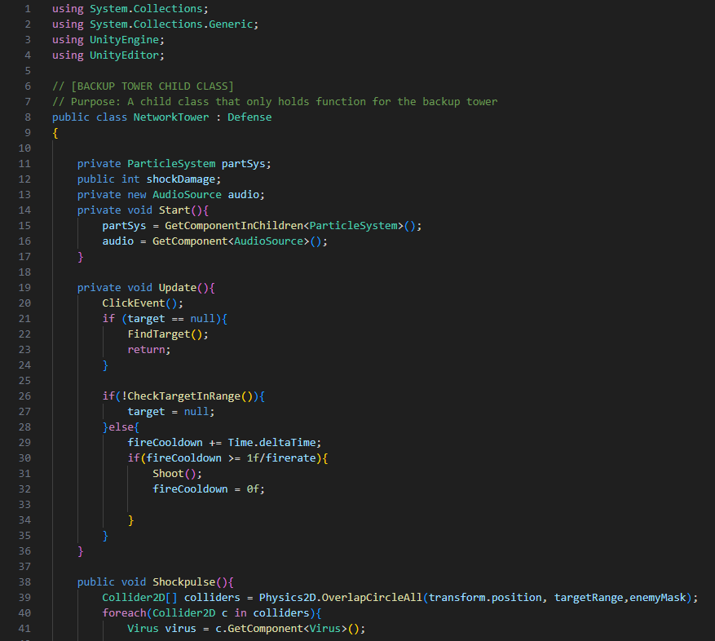
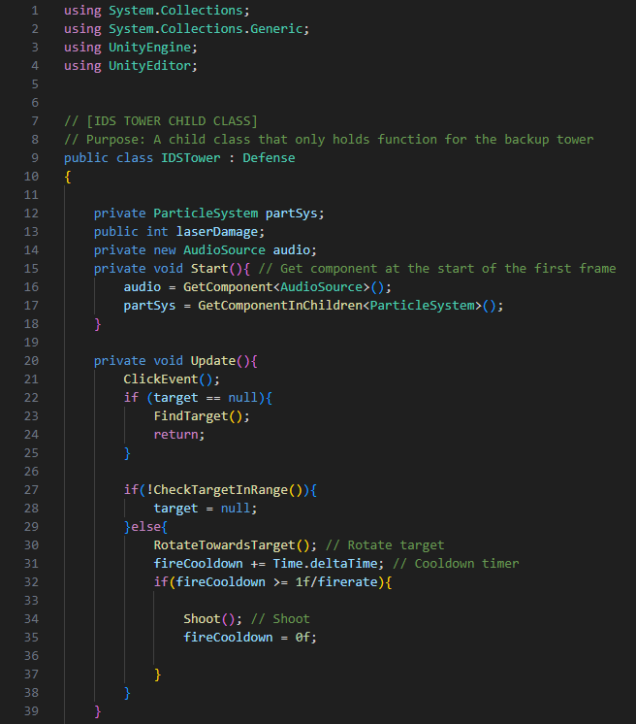
Tower Files
Top: Defenses.cs, FirewallTower.cs
Bottom: MalwareTower.cs, NetworkTower.cs, IDSTower.cs
Creates the unique logic for the different towers.

Slide 8
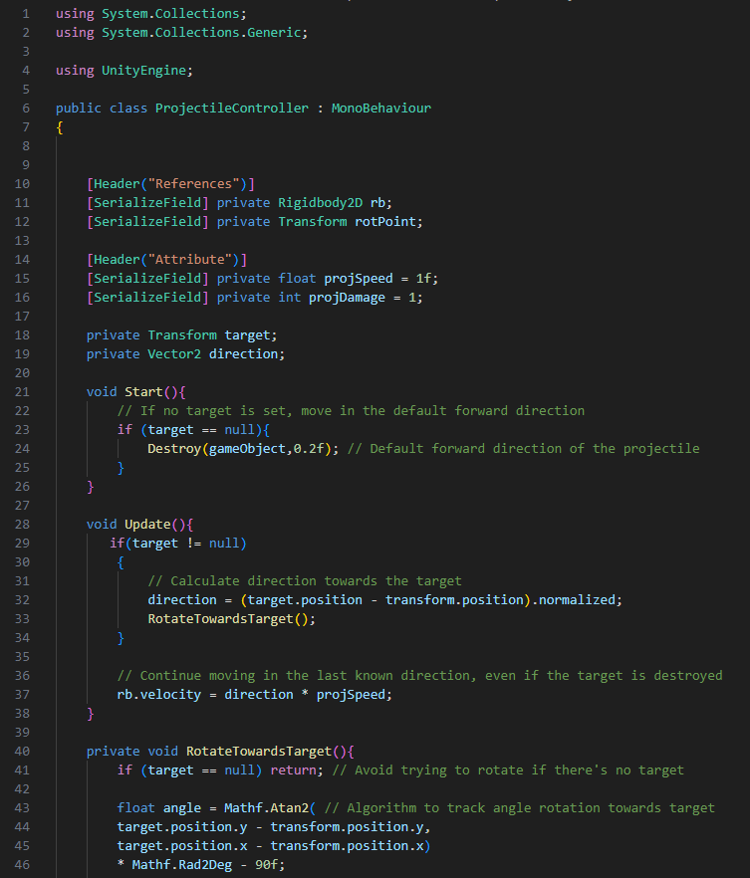
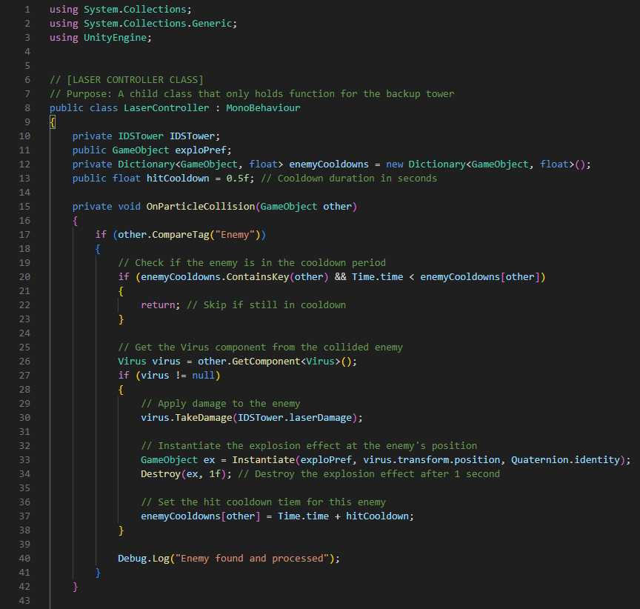
Tower Files
Left to Right: ProjectileController.cs, LaserController.cs
Handles the projectiles ejected from towers. Laser is only used for the IDS.

Slide 9
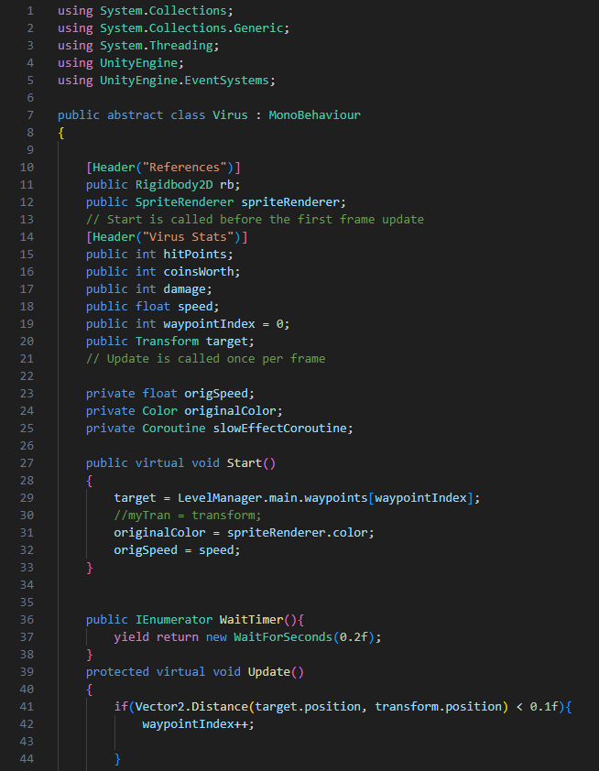
Virus Files
Virus.cs
Parent class to all of the different viruses

Slide 10
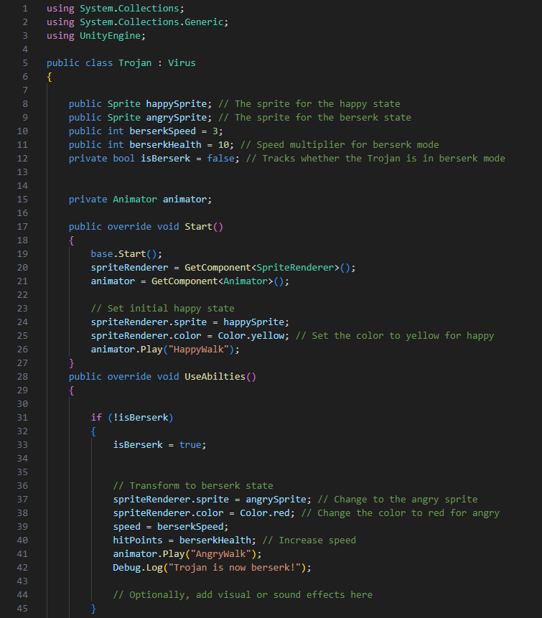
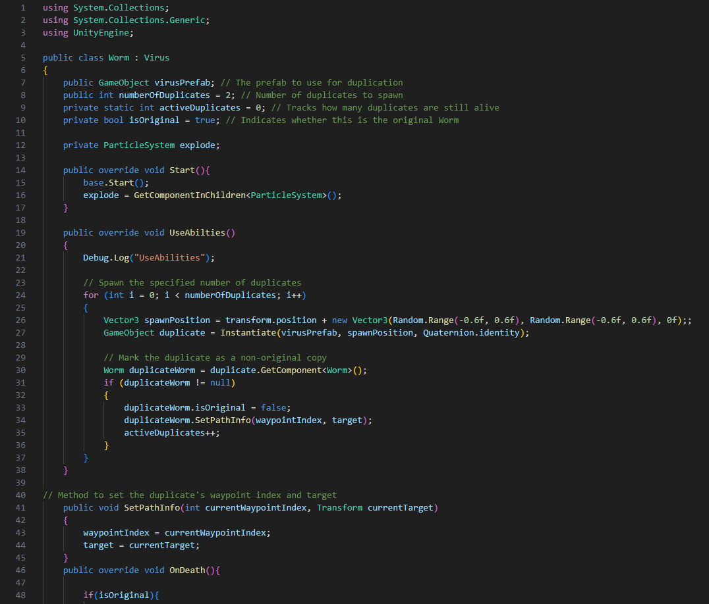
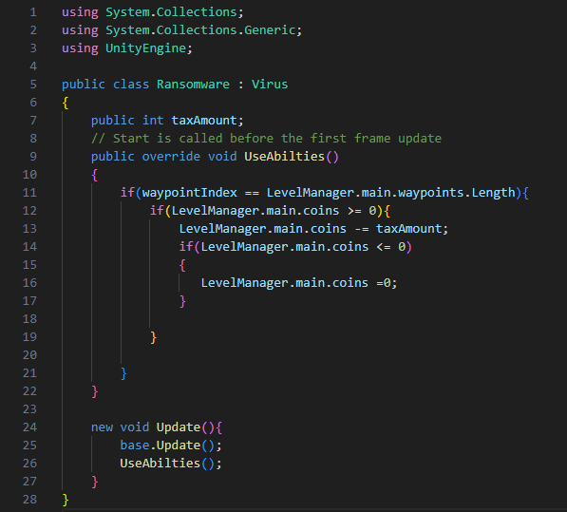
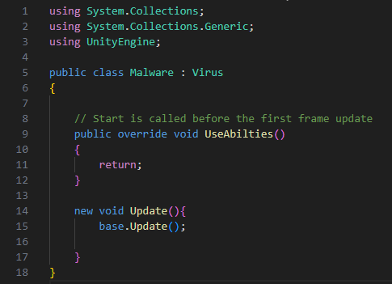
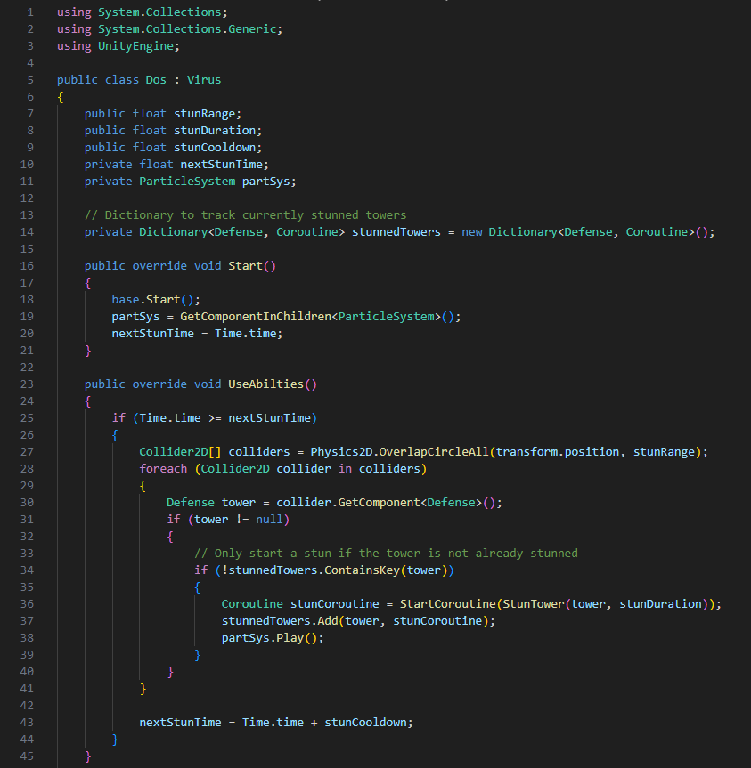
Virus Files
Top: Trojan.cs, Worm.cs
Bottom: Ransomware.cs, Malware.cs, Dos.cs
Inherits from the parent class to create different unique viruses

Slide 11
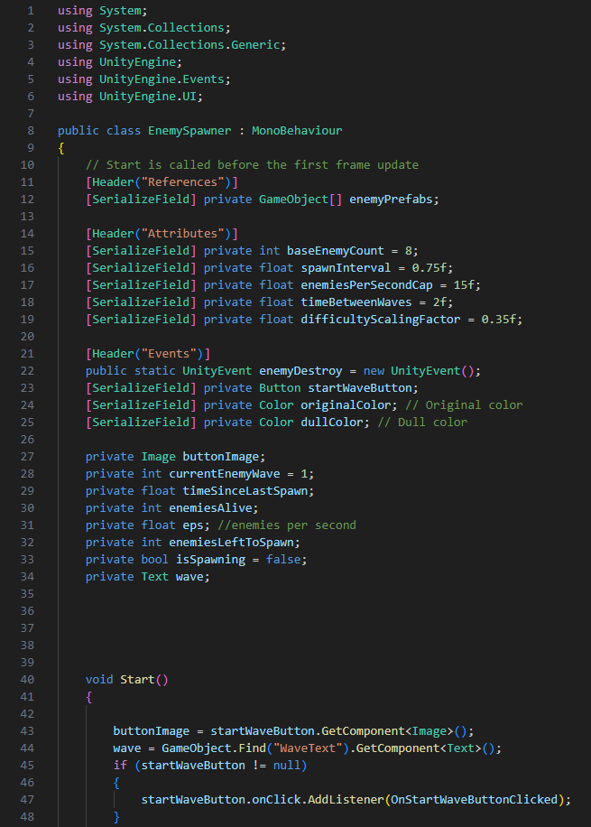
Virus Files
EnemySpawner.cs
Handles the spawning rate for viruses to appear

Slide 12
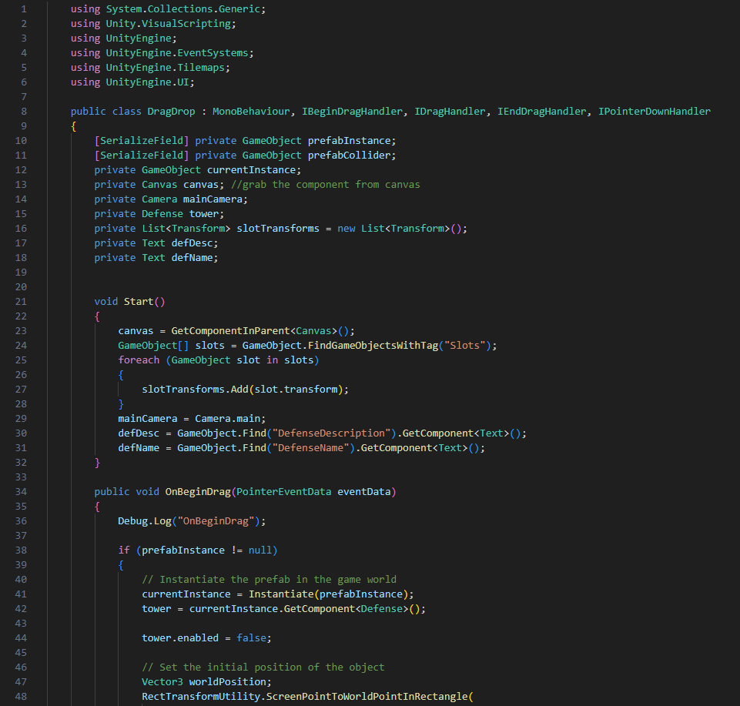
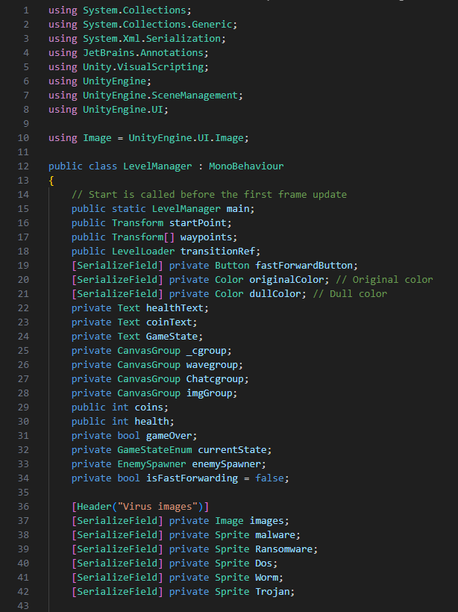
Game Files
Left to Right: DragDrop.cs, LevelManager.cs
Handles the game functions by letting users drag and drop towers to placeholders and managing the different levels

Slide 13
[Phishing Email Files]

Slide 14
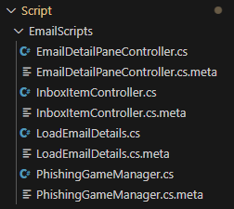
Folders
All of the Phishing Email files are located in the “EmailScripts” folder

Slide 15
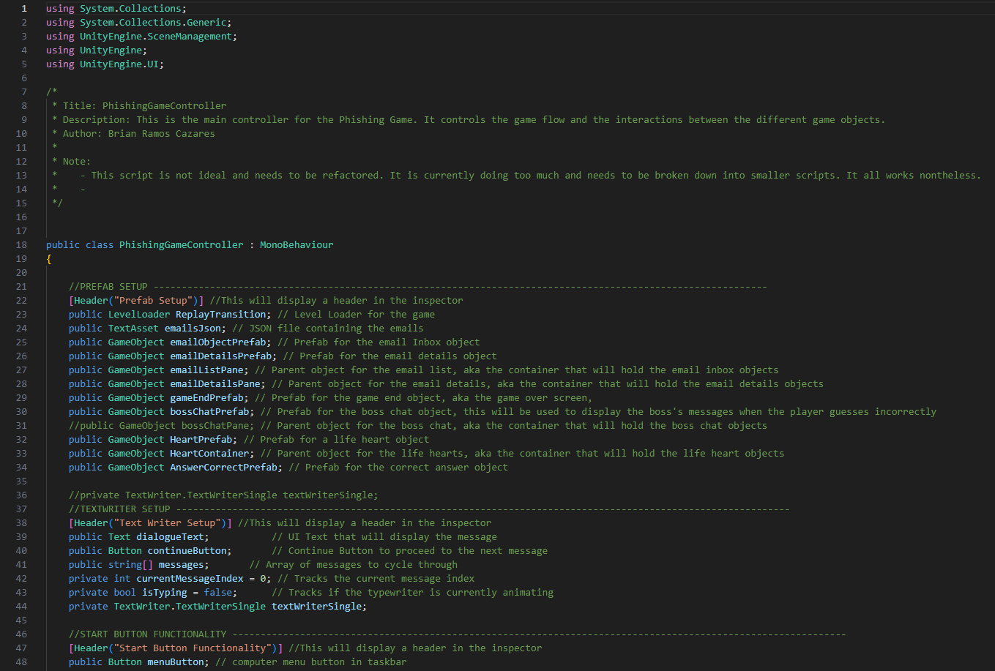
PhishingGameManager.cs
Main controller for the game that controls the game flow and interactions between different game objects.

Slide 16
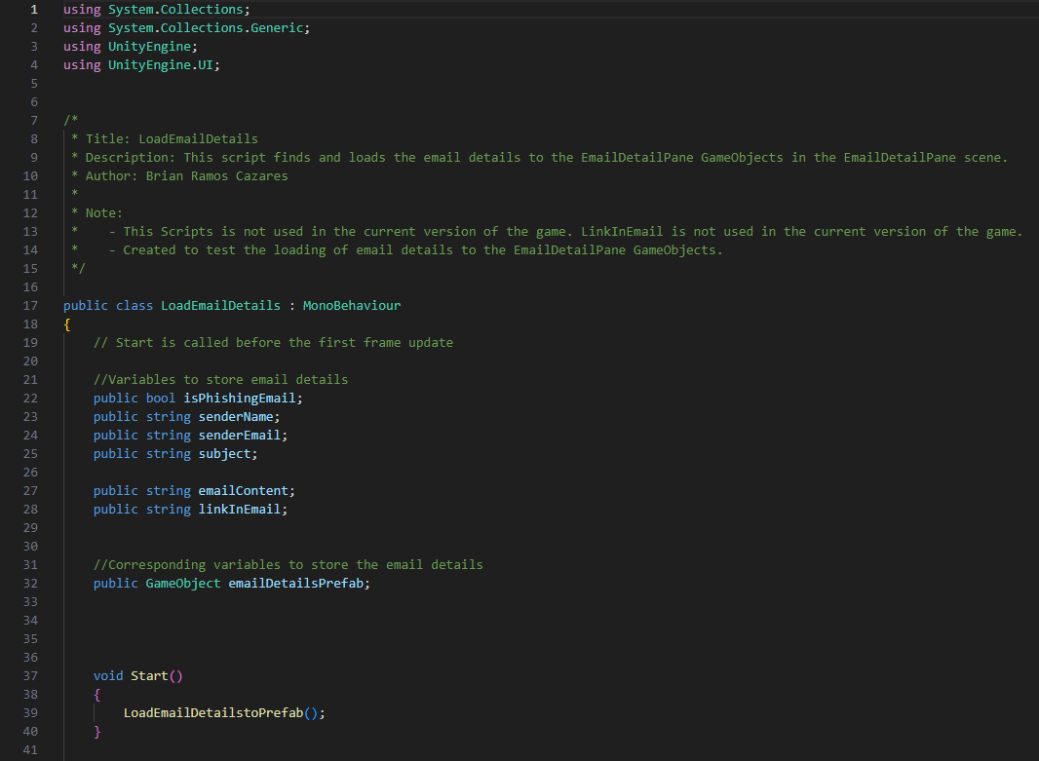
LoadEmailDetails.cs
Finds and loads email details to the EmailDetailPane

Slide 17
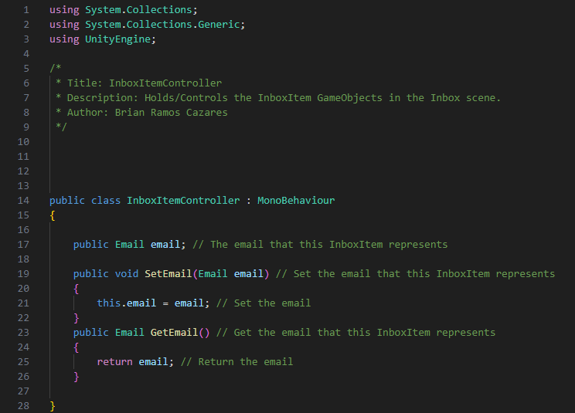
InboxItemController.cs
Holds and controls the InboxItem game objects in the Inbox scene

Slide 18
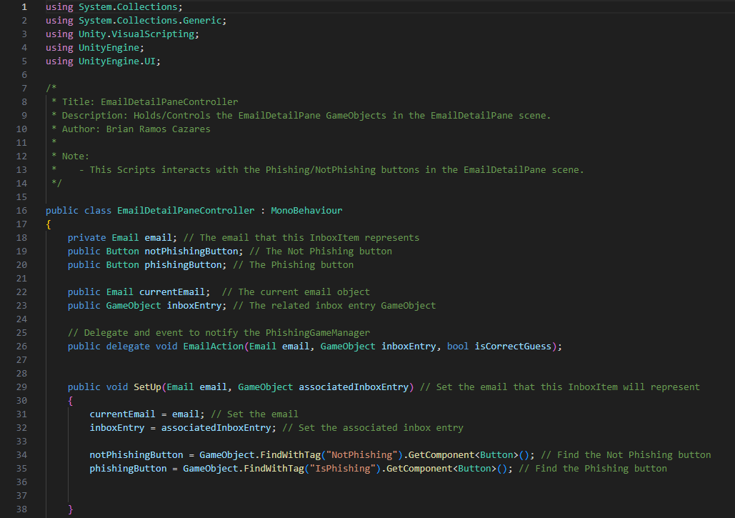
EmailDetailPaneController.cs
Holds and controls the EmailDetailPane game objects in the EmailDetailPane scene

Slide 19
[Other Files]

Slide 20
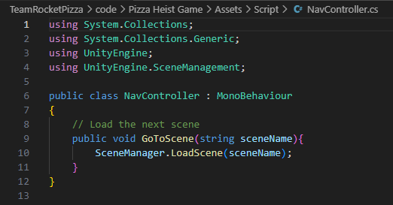
NavController.cs
Loads the next scene

Slide 21
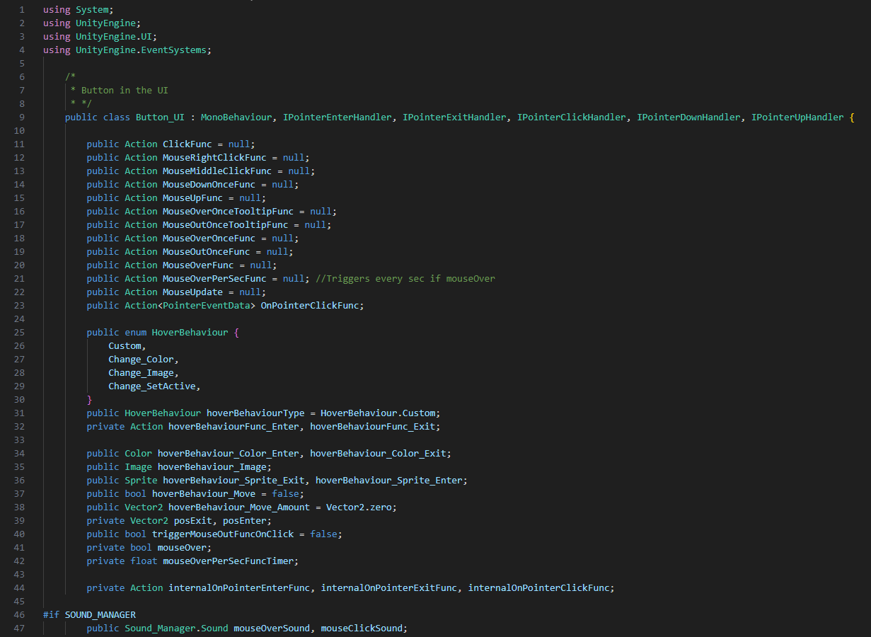
button_UI.cs
Handles the custom behavior set for the UI buttons, including triggering sound effects

Slide 22
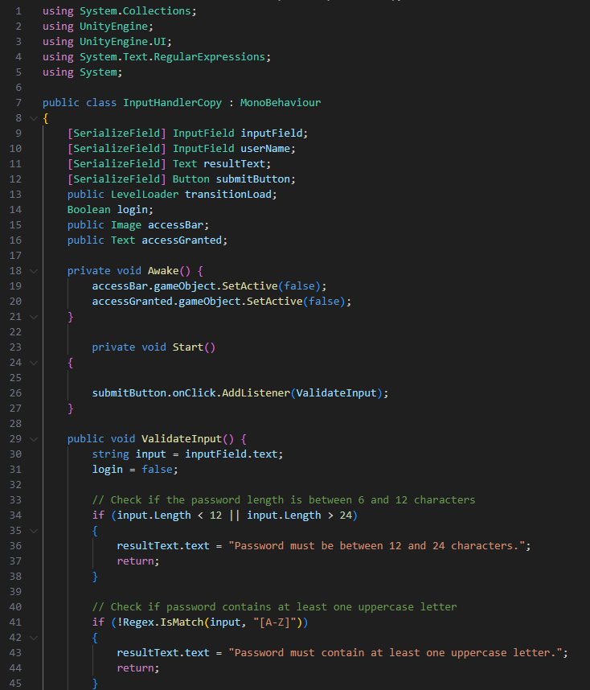
InputHandlerCopy.cs
Verifies input to pass specified constraints before proceeding to the next scene

Slide 23
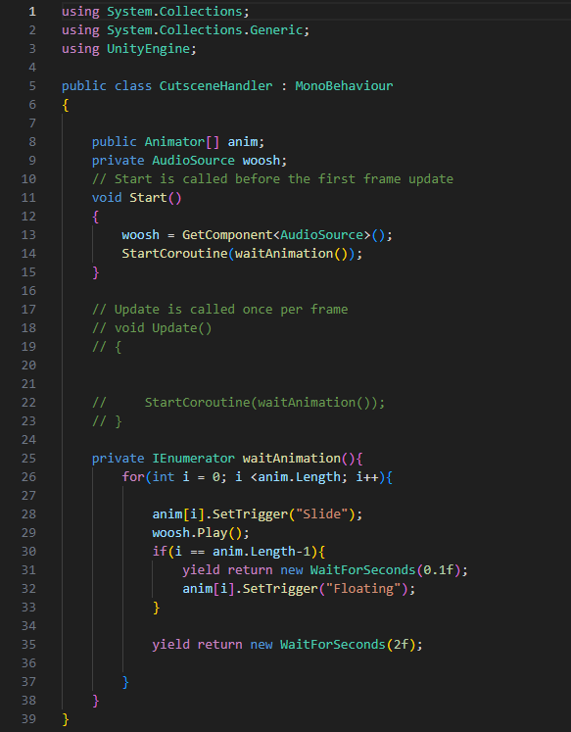
CutSceneHandler.cs
Handles the animations and sound effects used for the cutscene sequences

Slide 24
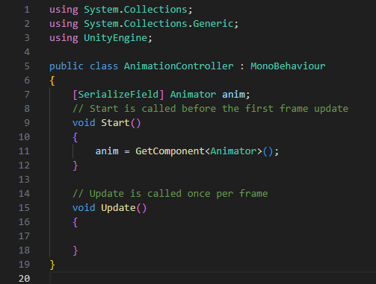
AnimationHandler.cs
Handles the animation for specified components

Slide 25
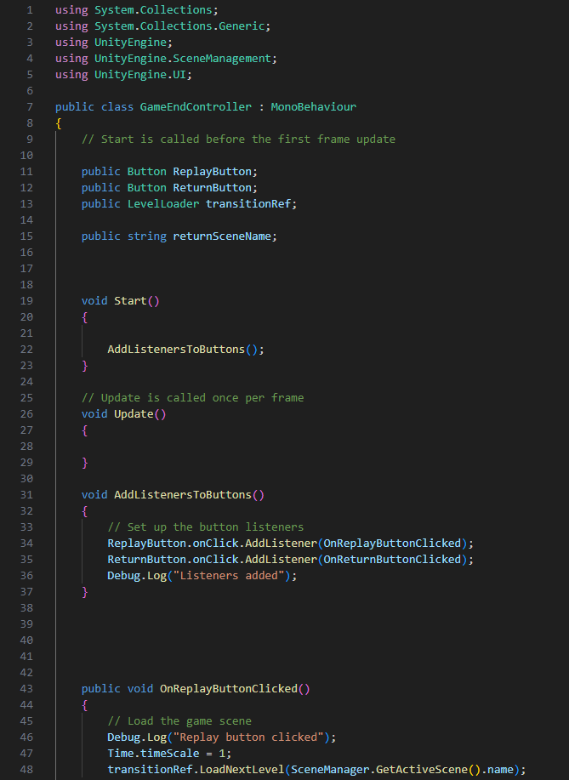
GameEndController.cs
Handles the game ending

